Slide 1
Predicting Toxicity With Deep Learning
By Sean Davern

Slide 2
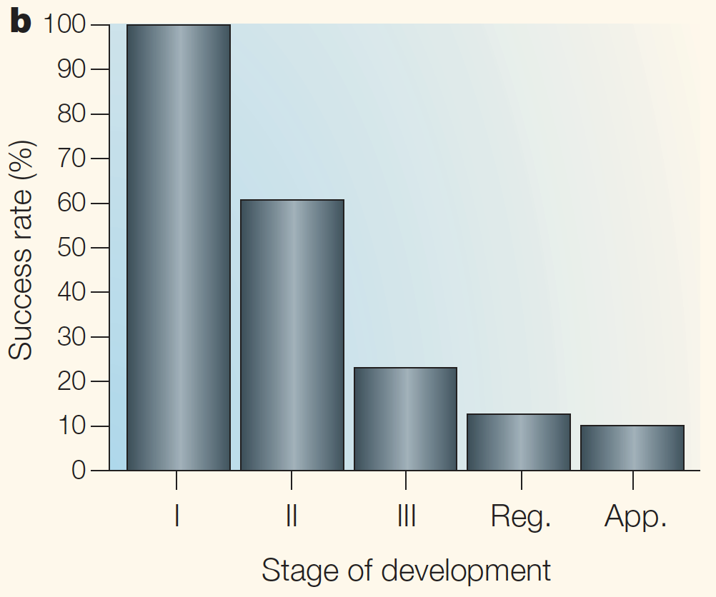
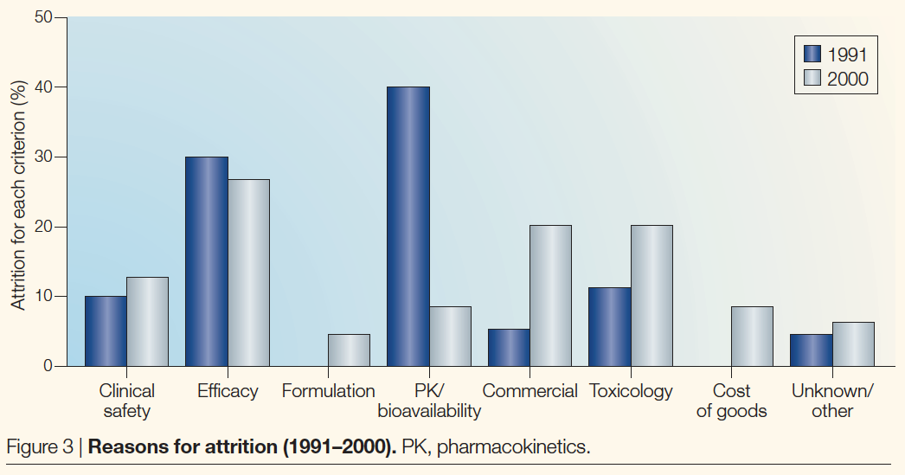
30% of Drugs Fail Clinical Trials due to Toxicity
Lawrence, Stacy. The Biotech Drug Market. Nat Biotechnol 22, 1496 (2004) doi:10.1038/nbt1204-1496
Notes:
This statistic was cited by NIH: https://tripod.nih.gov/tox21/challenge/about.jsp
2016 statistic was 17% (59 of 344 failures 1998-2015): https://www.ncbi.nlm.nih.gov/pubmed/27723879 - org article source: https://www.ncbi.nlm.nih.gov/pmc/articles/PMC6092479/

Slide 3
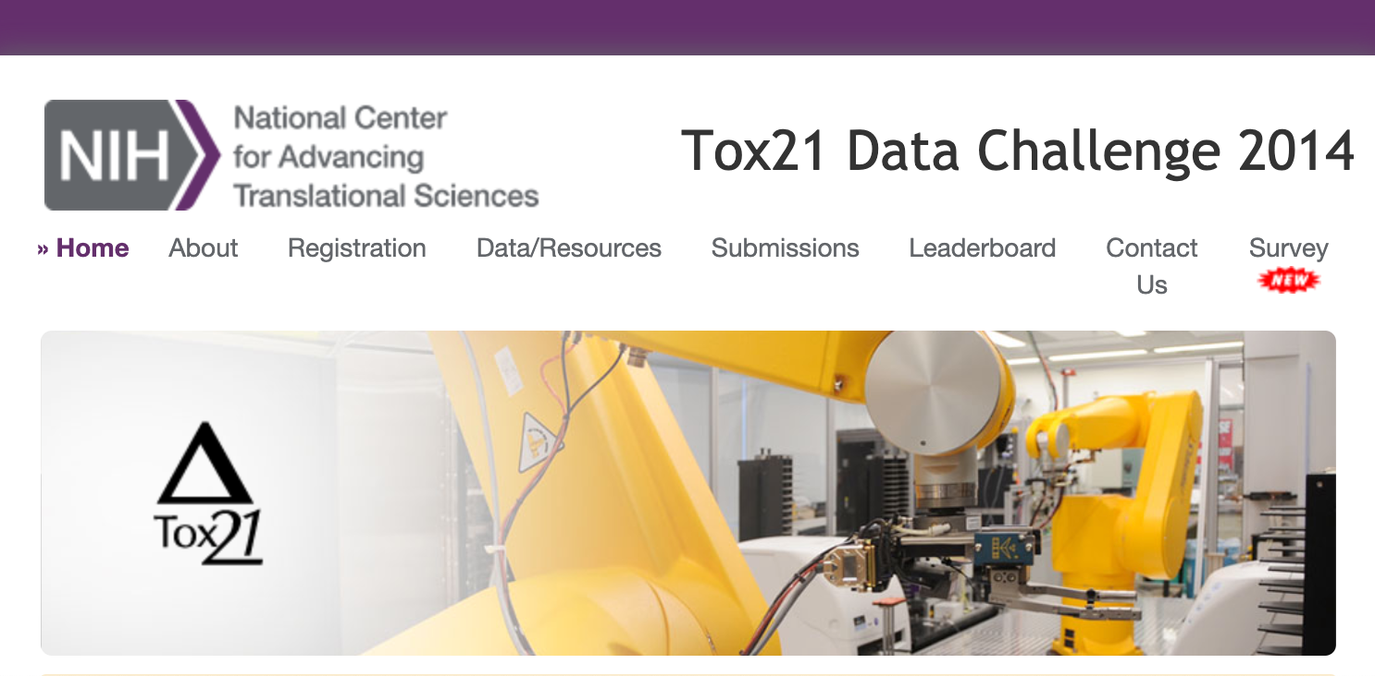
Data
Obtain Data
Scrub
Explore
Model
Use
12,700 Compounds
800 Physiochemical and >272,000➜844 Structural Features
12 Toxicity measures

Slide 4
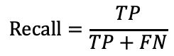
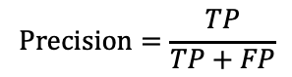
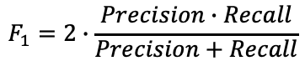
[Business] Metrics
Obtain Data
Scrub
Explore
Model
Use
 |  | Prediction
 |  | Non-Toxic | Toxic
 | Non-Toxic | True Negative 90% | False Positive (Unnecessary Cost, Rejected Candidate)
 | Toxic | False Negative (Clinical Failure) | True Positive 10%
$$F_{1}=2∙\frac{Precision∙Recall}{Precision+Recall}$$
Truth
$$Recall=\frac{TP}{TP+FN}$$
$$Precision=\frac{TP}{TP+FP}$$

Slide 5

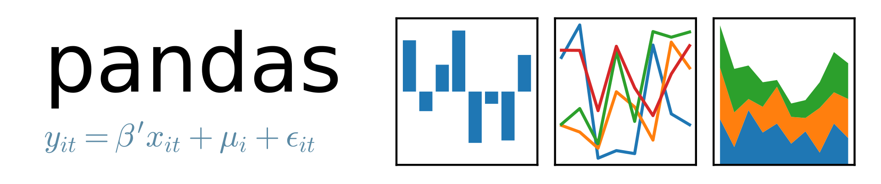
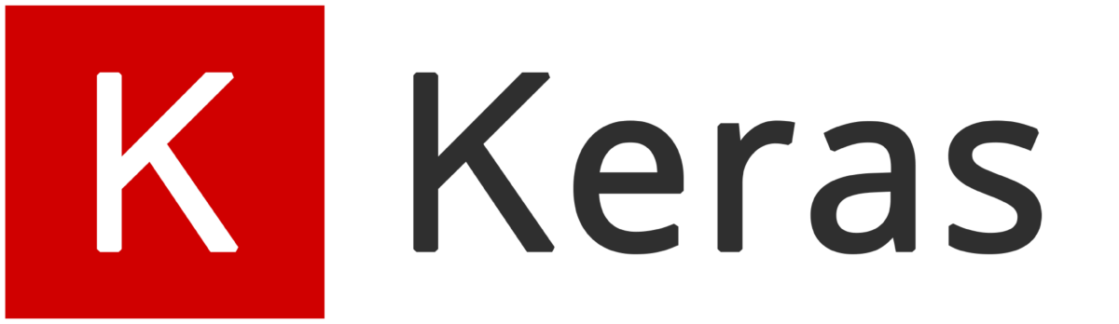
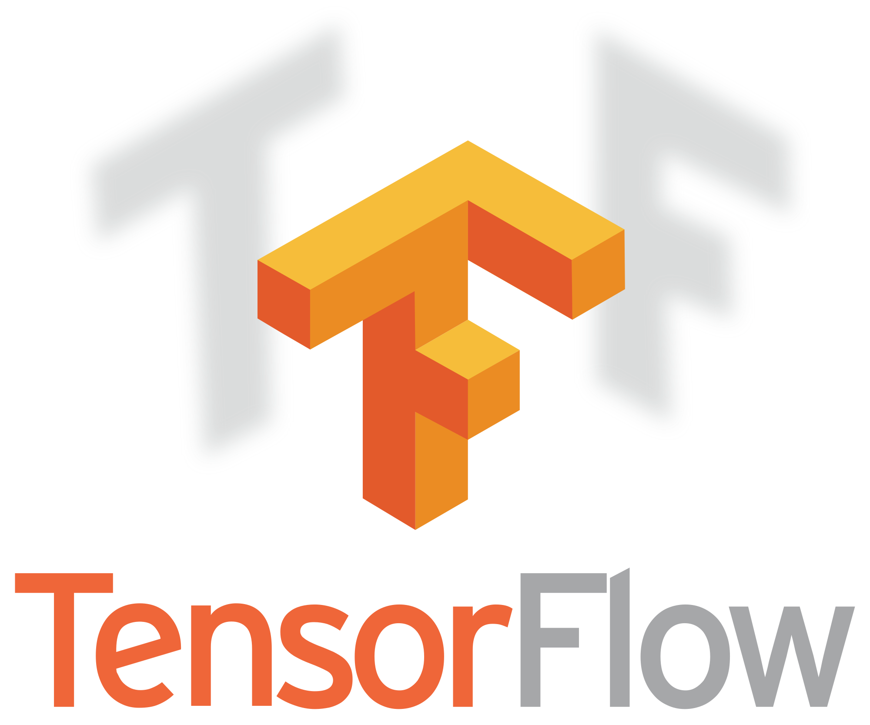




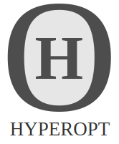

Modeling
Obtain Data
Scrub
Explore
Model
Use
Data Handling, Pre-Processing
Neural Network Design & Training
Metrics, Visualization
Hyperparameter Tuning
(Bayesian Optimization)
imblearn

Slide 6
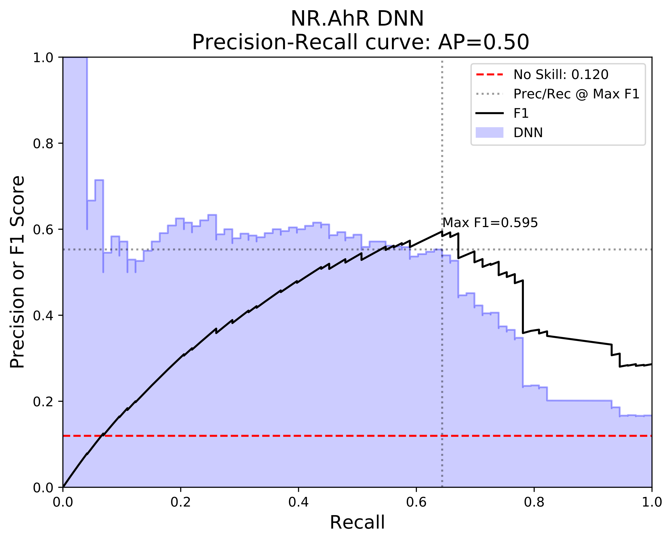
Modeling
Obtain Data
Scrub
Explore
Model
Use
Decision Threshold = 0.7

Slide 7
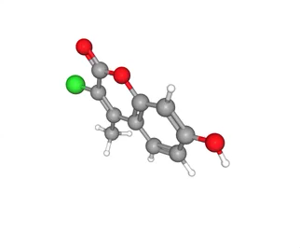
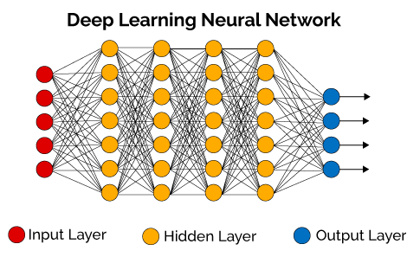
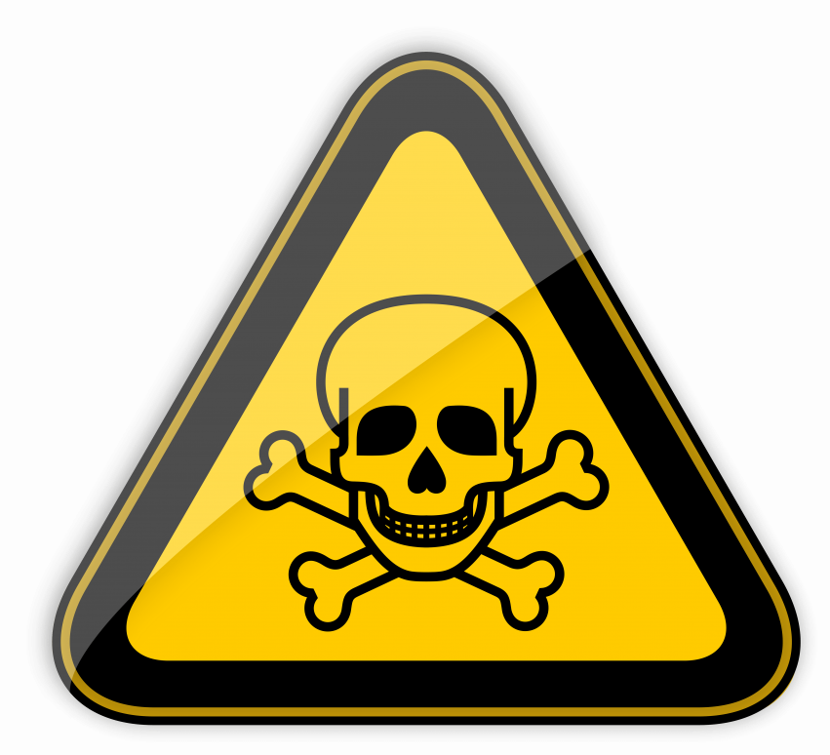
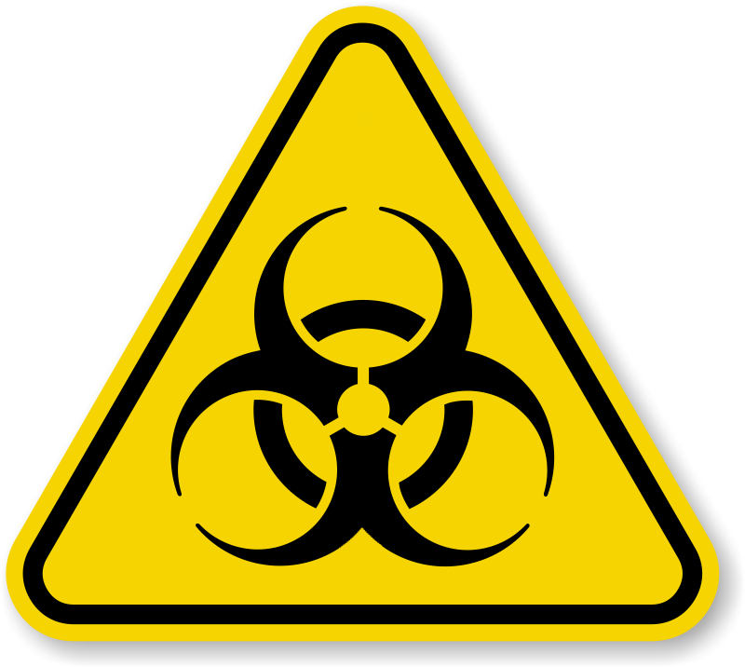
THANKS
Dense Neural Networks
Please contact me with any questions?
Sean Davern
sean@lizandsean.com
(206) 919-2026

Slide 8
Appendix

Slide 9
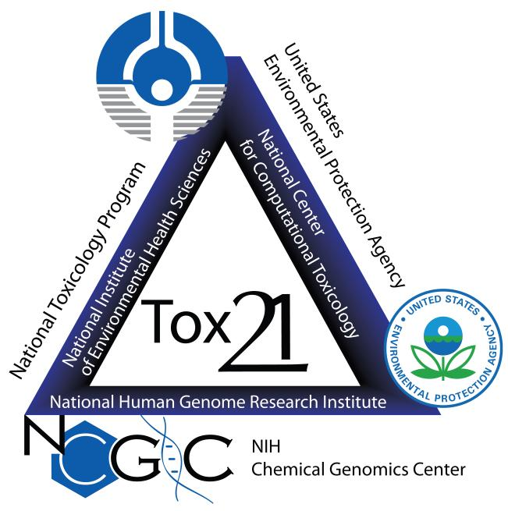
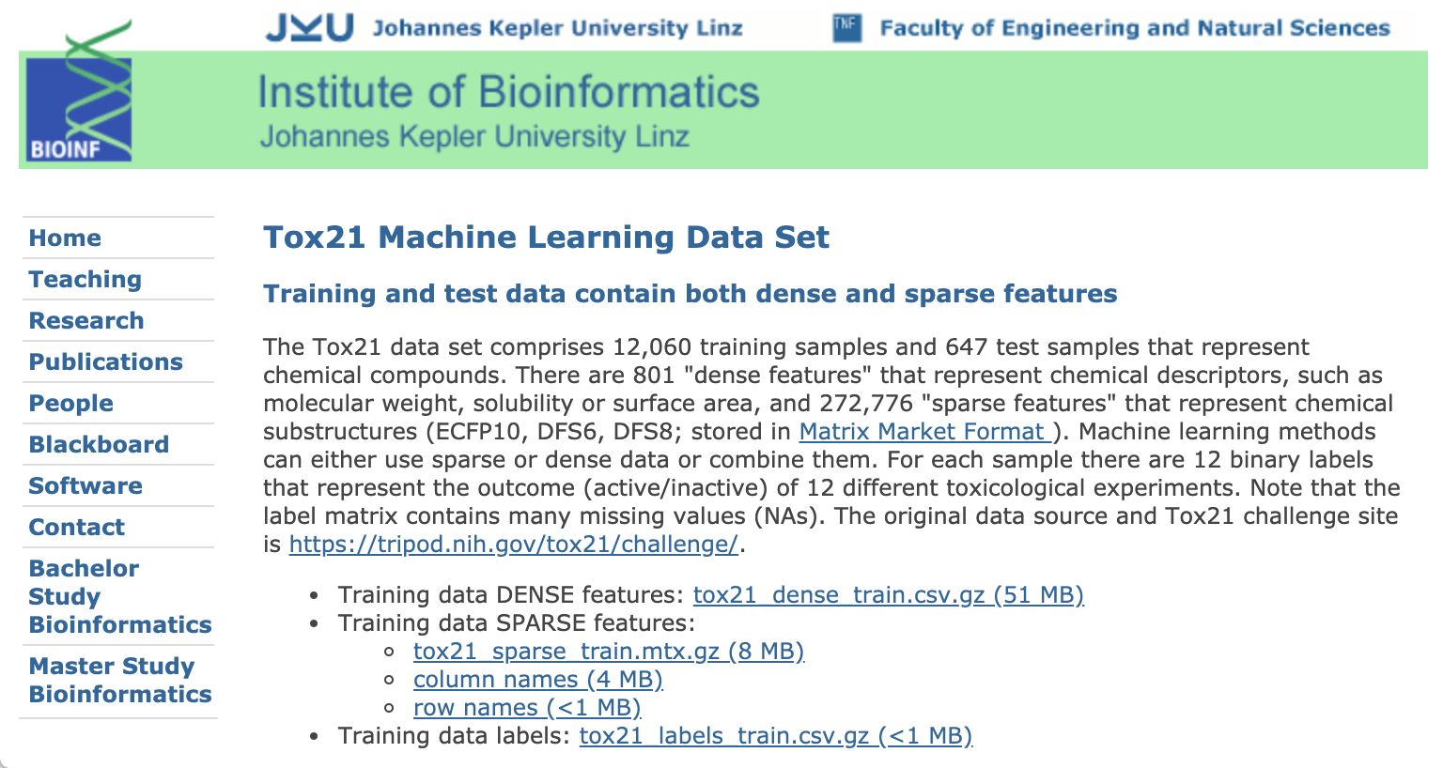
Government Program to Data Set
Notes:
In 2005 the EPA initiated a long-range vision for toxicity testing. In 2014 the NIH held its Tox21 Data Challenge providing a data set of 12,060 compounds and the results of 12 well defined analytical tests that indicate human toxicity in one or several metabolic pathways. In 2016 Johannes Keppler University in Linz, Austria made the data set available for machine learning projects.

Slide 10
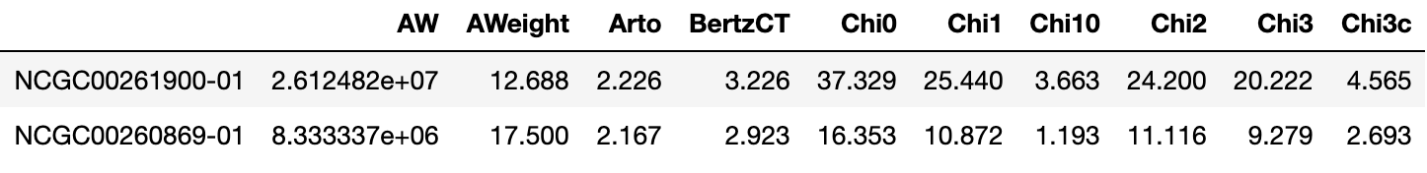
Data
For 12,060 training + 647 test compounds:
Inputs (X)
801 physio chemical compound features
2 stereo spatial fingerprint encodings → 272,000 features
Targets (Y)
12 binary indicators of toxicity against a specific test method

Slide 12
Template Content

Slide 13
BACKGROUND
MERCURY
MARS
VENUS
SATURN
Mercury is the closest planet to the Sun and the smallest one in the Solar System
Despite being red, Mars is a cold place, not hot. It’s full of iron oxide dust
Venus has a beautiful name and is the second planet from the Sun
Saturn is the ringed planet. It’s a gas giant, composed mostly of hydrogen and helium

Slide 14
AWESOME WORDS

Slide 15
RESEARCH AND PUBLICATIONS
1.
2.
3.
by MARS
by VENUS
by MERCURY
Despite being red, Mars is actually a cold place. It’s full of iron oxide dust, which gives the planet its reddish cast
Venus has a beautiful name and is the second planet from the Sun. It’s terribly hot, even hotter than Mercury
Mercury is the closest planet to the Sun and the smallest one in the Solar System—it’s only a bit larger than our Moon

Slide 16
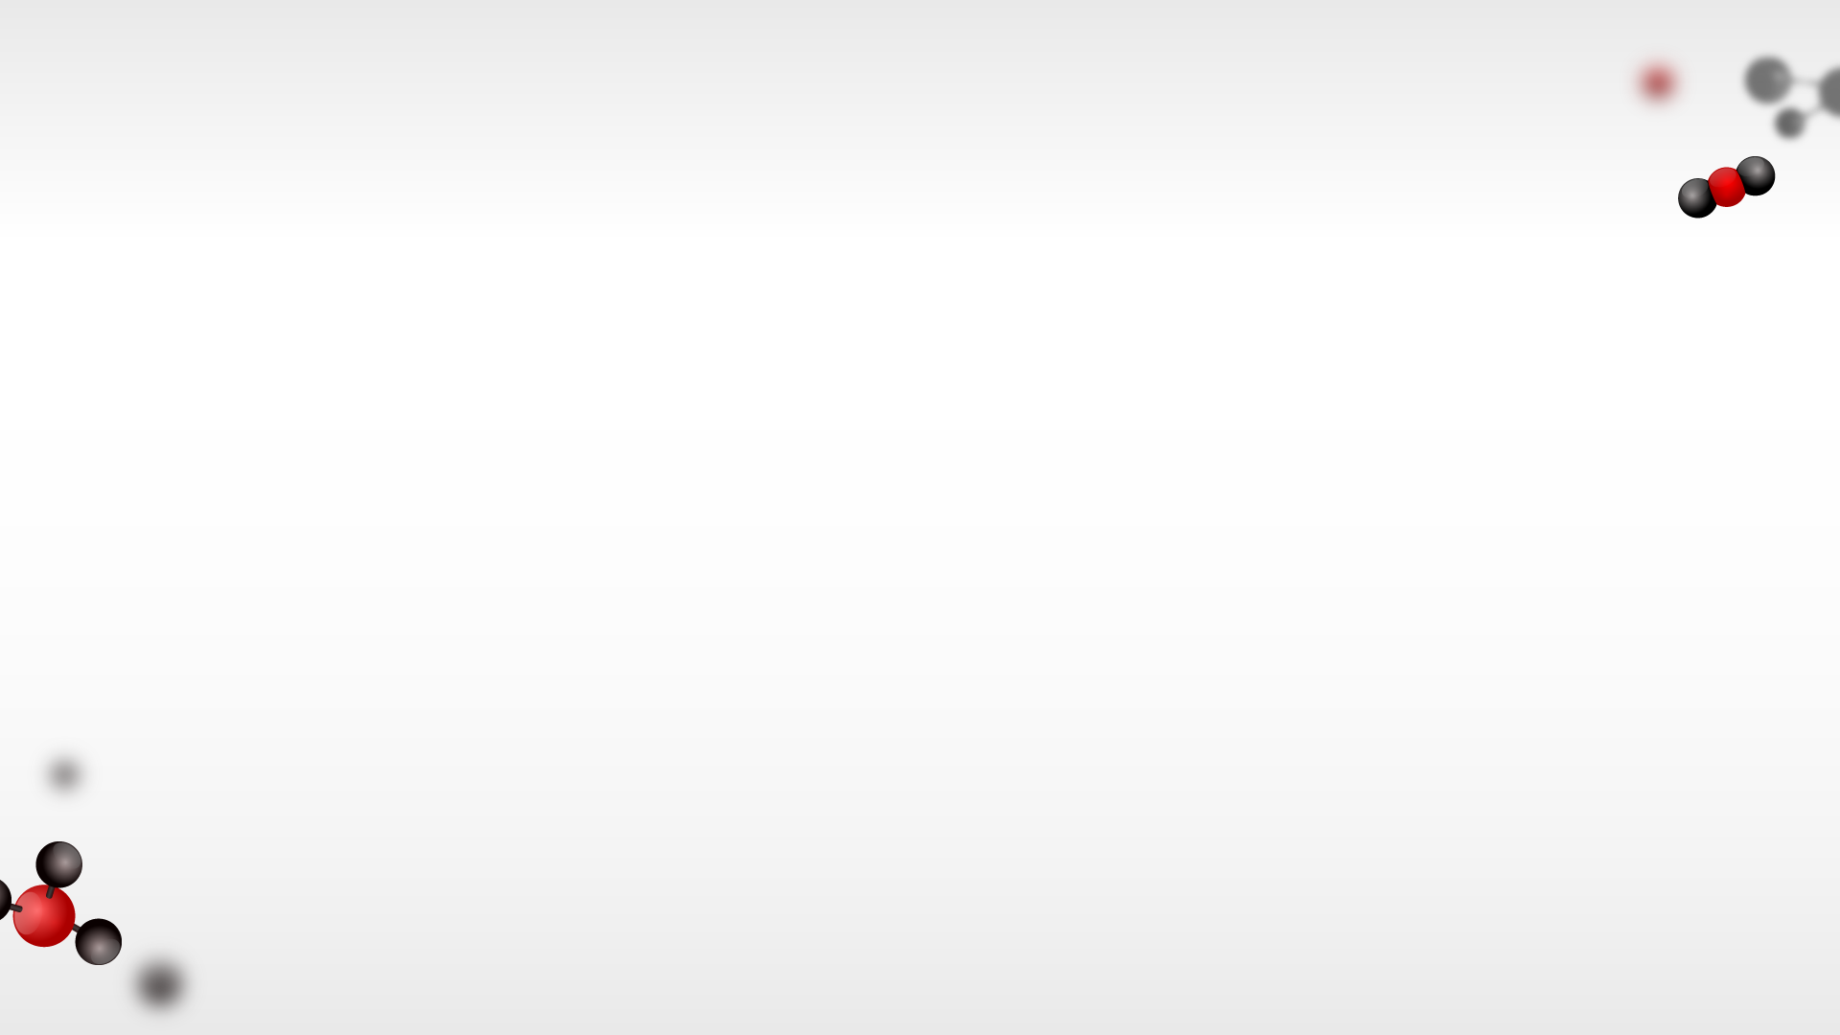
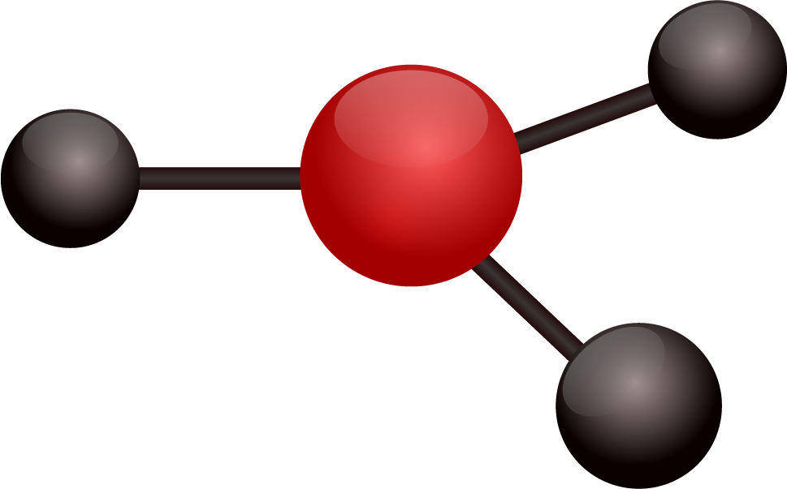
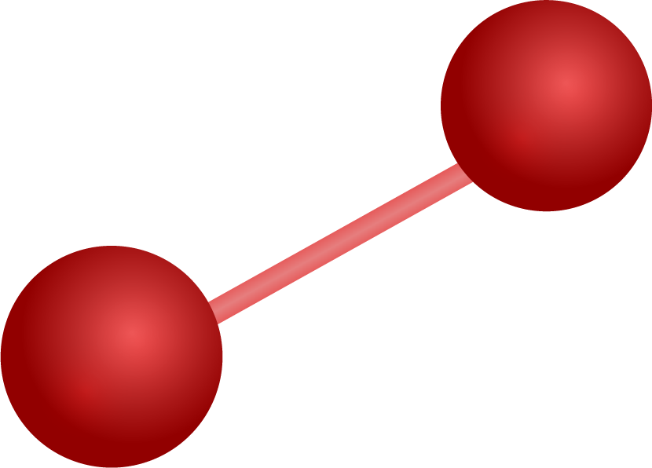
RESEARCH RESOURCES
Here you can list your reference websites or publications.
Here you can list your reference websites or publications.
Here you can list your reference websites or publications.
Here you can list your reference websites or publications.
Here you can list your reference websites or publications.
Here you can list your reference websites or publications.

Slide 17
FACTORS TO CONSIDER
1.
MARS
3.
JUPITER
5.
SATURN
2.
MERCURY
4.
NEPTUNE
6.
VENUS
Despite being red, Mars is a cold place, not hot. It’s full of iron oxide dust
It’s the biggest planet in our Solar System and the fourth-brightest object in the sky
Yes, this is the ringed one. It’s a gas giant, composed of hydrogen and helium
Mercury is actually the smallest planet in our Solar System
Neptune is the fourth-largest planet by diameter in our Solar System
Venus has a beautiful name and is the second planet from the Sun. It’s terribly hot

Slide 18
01
TITLE GOES HERE
You can enter the subtitle here if you need it

Slide 19
CLINICAL TRIAL
PHASES
DOSE
SAMPLE SIZE
PRECLINICAL
SAFETY
DOSING
EFFICACY
LONG TERM SAFETY
0
I
II
III
IV

Slide 20
TRIAL TIMELINE
RESEARCH
CONCLUSIONS
PRECLINICAL
1
3
5
2
4
EXPERIMENTATION
RESULTS
Despite being red, Mars is actually a cold place
Mercury is the closest planet to the Sun
Jupiter is the biggest planet in our Solar System
Venus has a beautiful name, but it’s terribly hot
Neptune is the farthest planet from the Sun

Slide 21
PHASE 1
SAMPLE SIZE
80%
GOAL
SUCCESS RATE
SECONDARY EFFECTS
DOSE
RESULTS
6 MONTHS
Young healthy people
20 - 80 participants
Not expected to benefit from the medicine
Study the safety of medication
Subtherapeutic, with ascending doses
Venus has a beautiful name and is the second planet from the Sun. It’s terribly hot—even hotter than Mercury—and its atmosphere is extremely poisonous
Mars
Venus
Mercury
Jupiter
Saturn
Neptune
Experimentation time

Slide 22
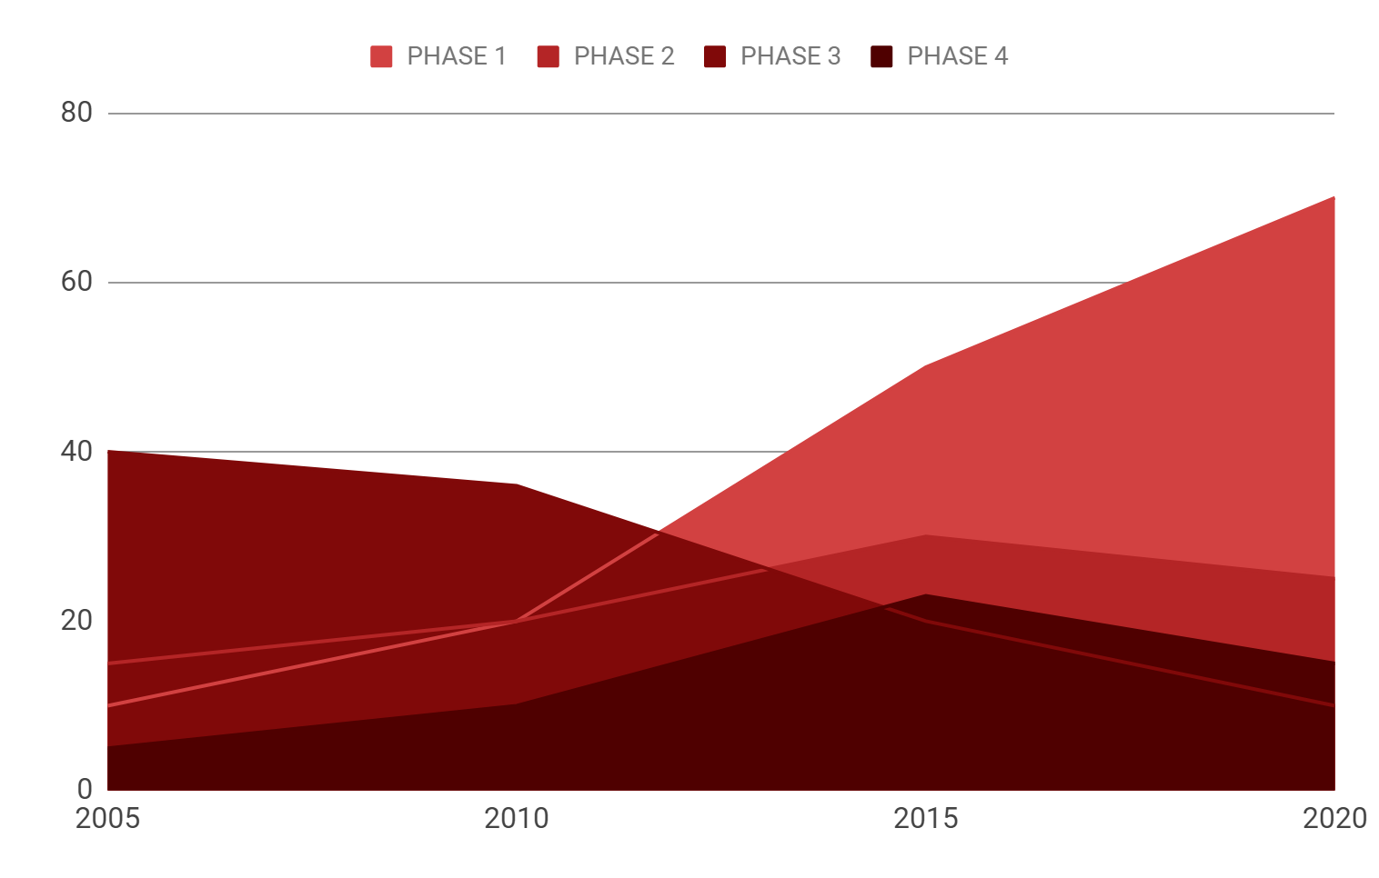
TENDENCY
Mercury is the closest planet to the Sun and the smallest one in the Solar System—it’s only a bit larger than our Moon. The planet’s name has nothing to do with the liquid metal, since it was named after the Roman messenger god
If you want to modify this graph, click on them, follow the link, change the data and replace them

Slide 23
RESULTS
EXPERIMENT A
EXPERIMENT B
TREATMENT | Test 1 | Test 2 | Test 3
Group 1 | 315 | 285 | 600
Group 2 | 210 | 390 | 600
Group 3 | 240 | 165 | 580
TREATMENT | Test 1 | Test 2 | Test 3
Group 1 | 189 | 285 | 474
Group 2 | 210 | 234 | 444
Group 3 | 367 | 123 | 396

Slide 24
RESULTS ANALYSIS
SATURN
NEPTUNE
VENUS
25%
75%
MARS
JUPITER
60%
Venus
90%
Mars
50%
Mercury
Venus
Mercury
Mars
Venus has a beautiful name, but it’s terribly hot
Despite being red, Mars is actually a cold place

Slide 25
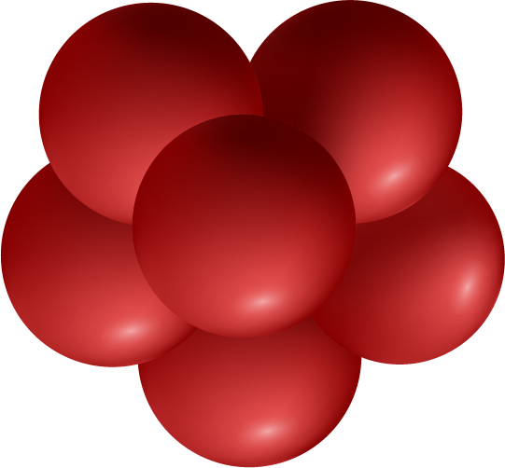
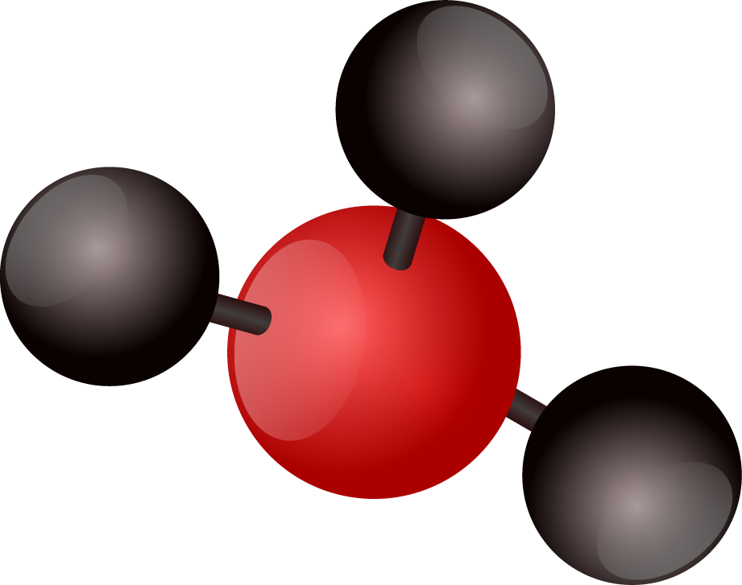
SUCCESS RATE
75%
PATIENTS CURED
97%
WITHOUT SECONDARY EFFECTS

Slide 26
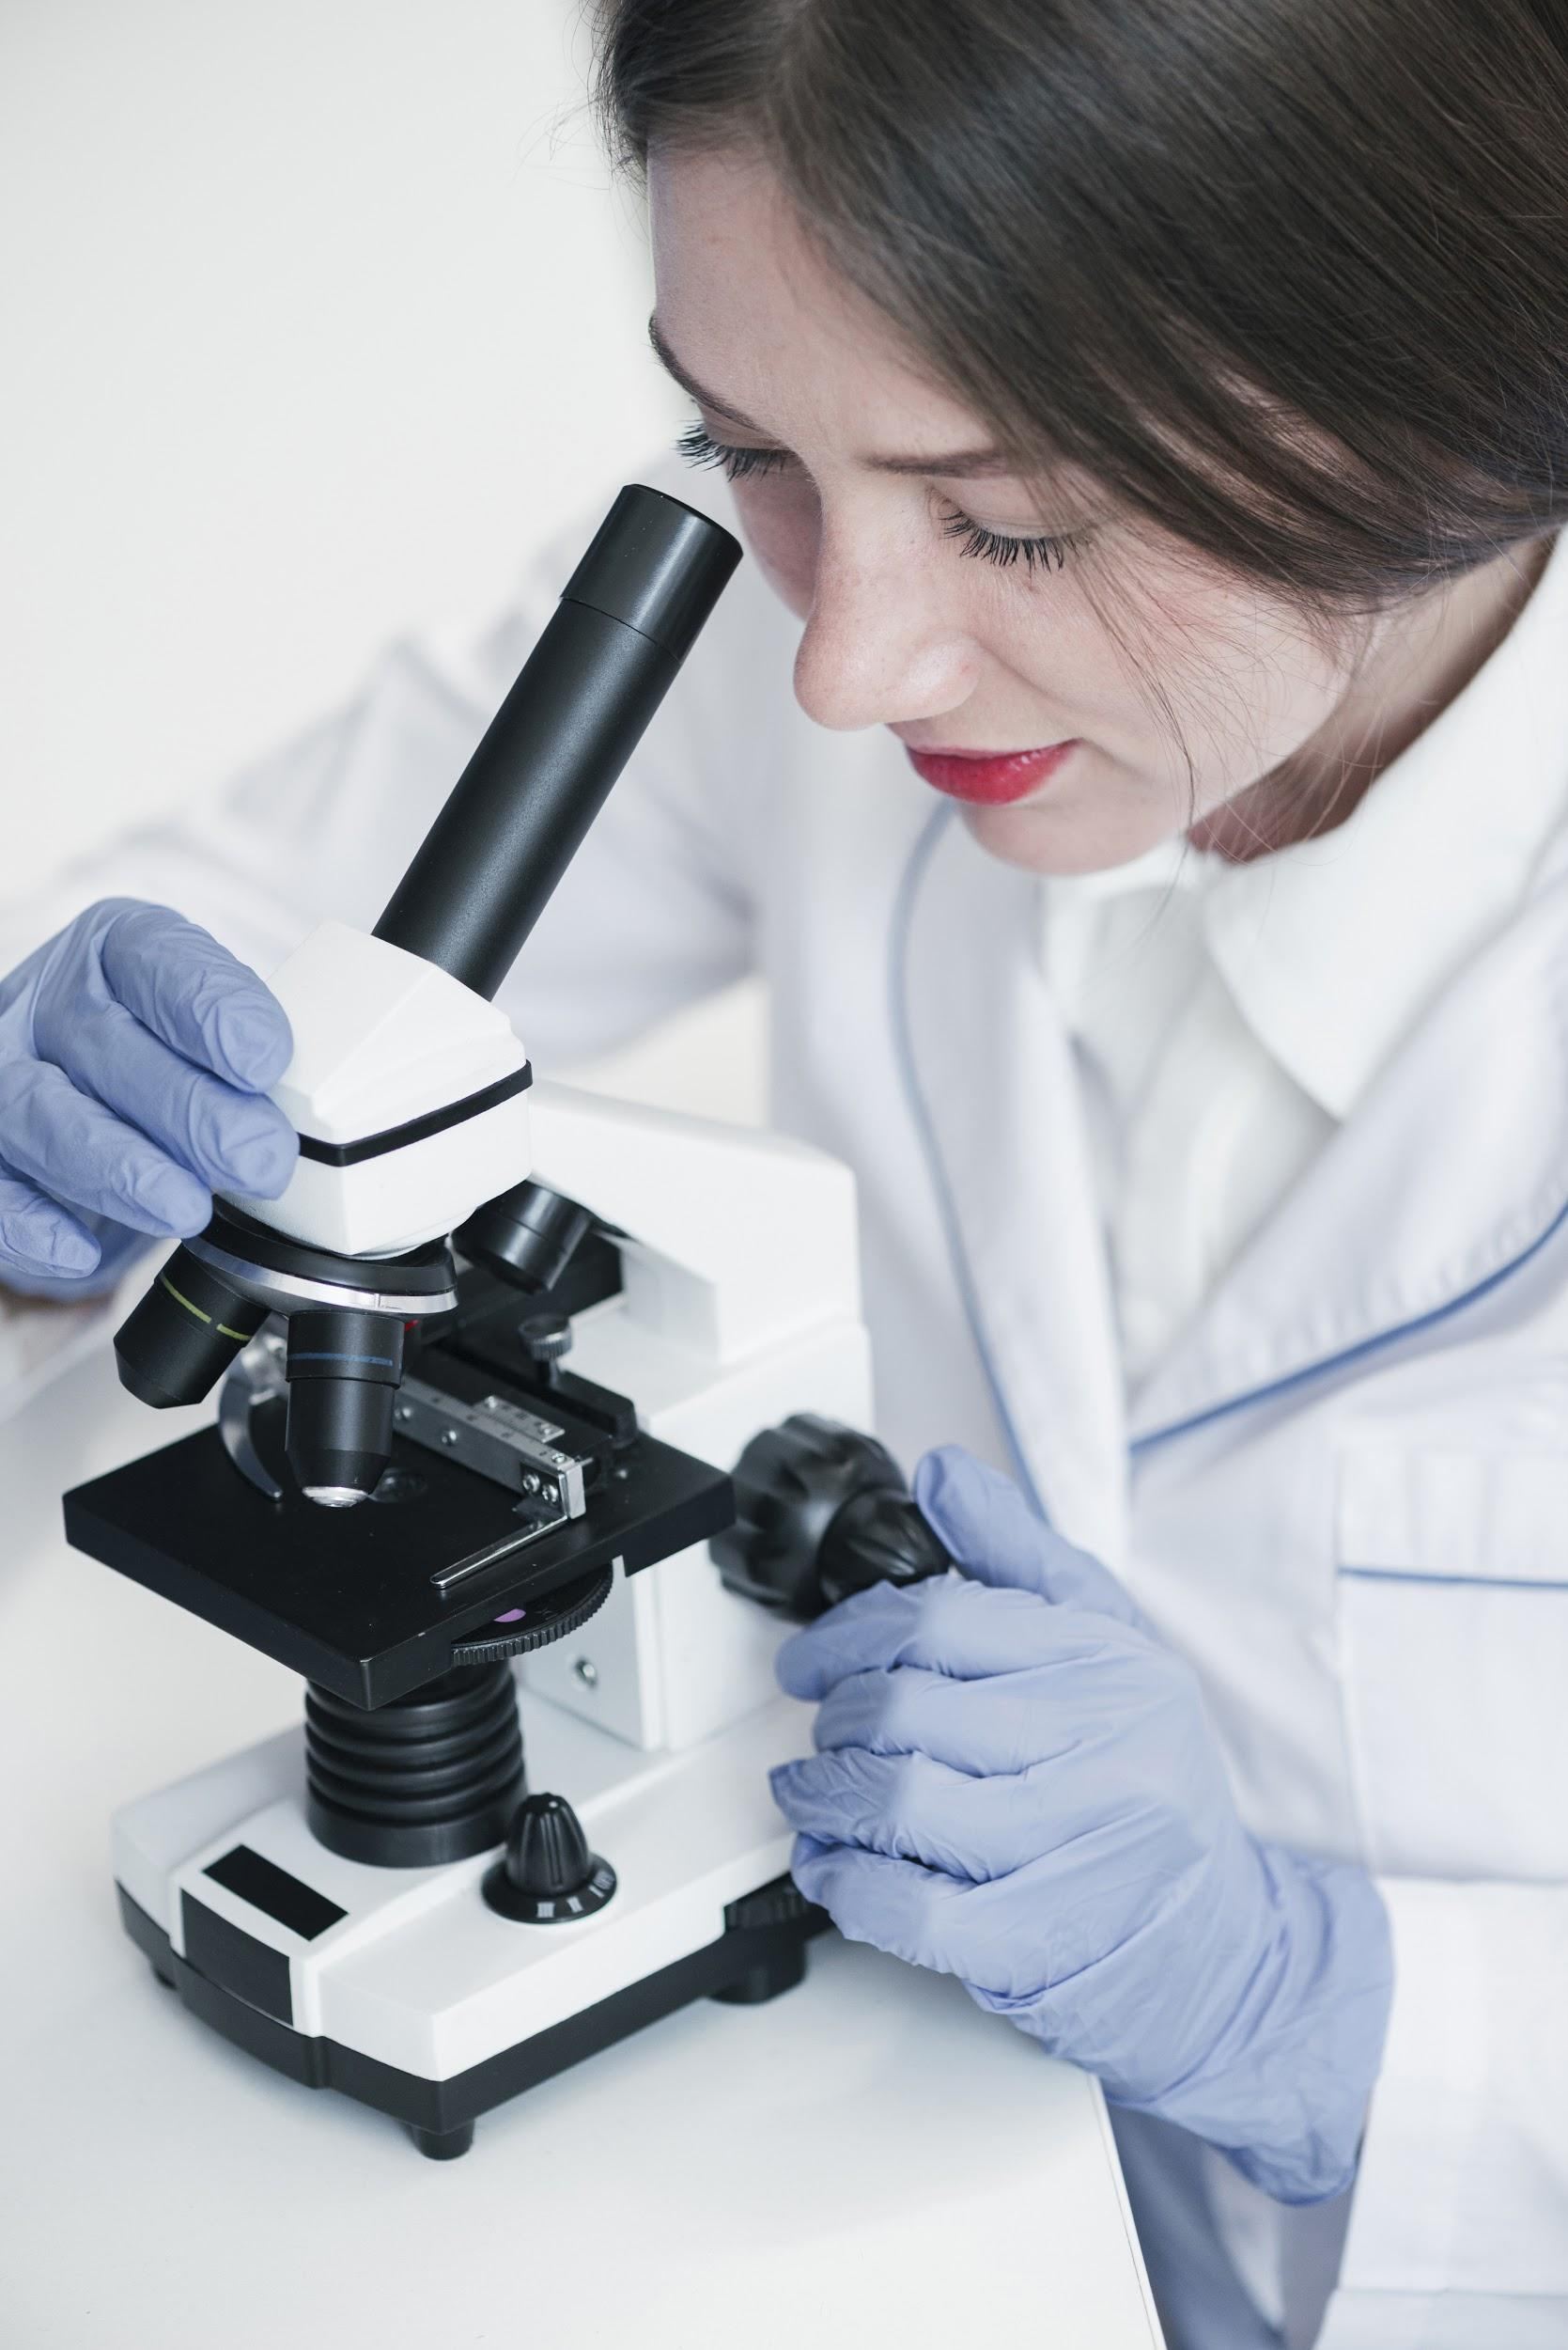
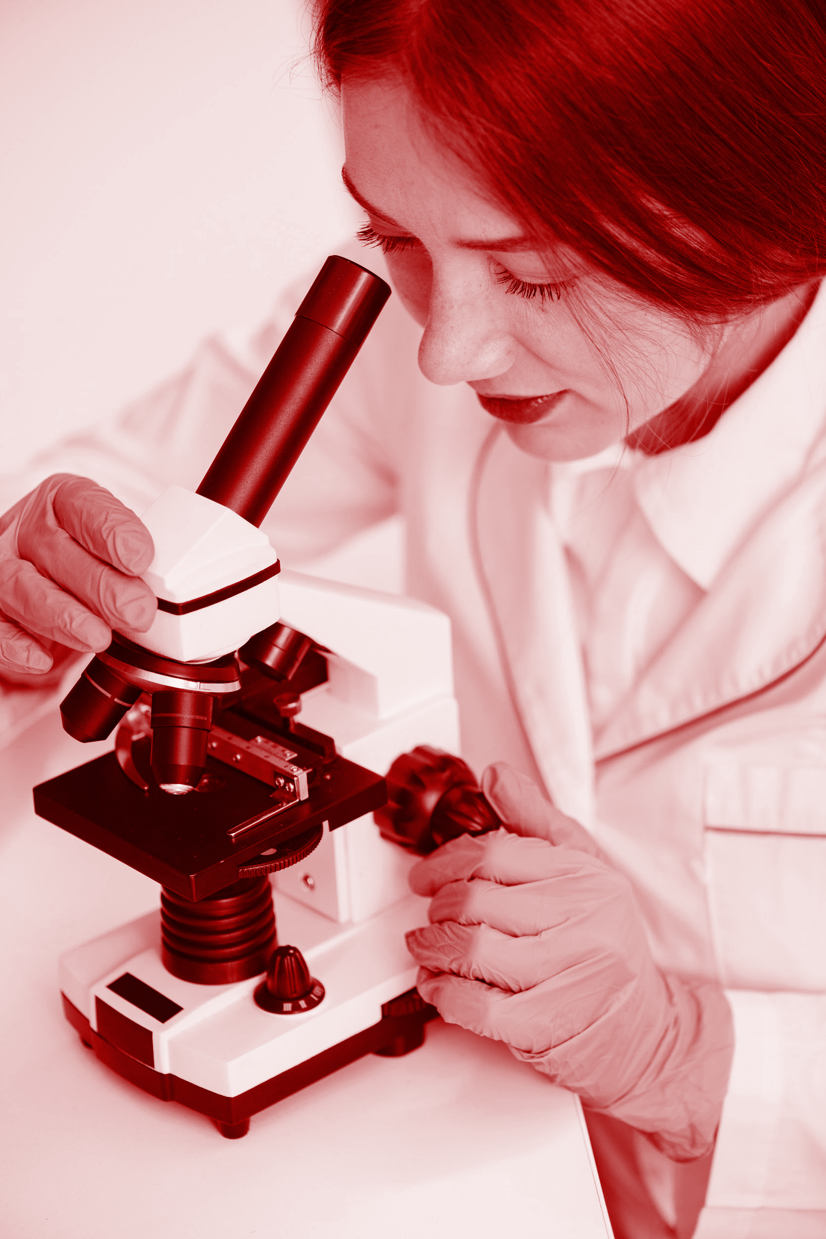
CONCLUSIONS
Mercury is the closest planet to the Sun and the smallest one in the Solar System—it’s only a bit larger than our Moon. The planet’s name has nothing to do with the liquid metal, since it was named after the Roman messenger god, Mercury

Slide 27
HEALTH ICONS

Slide 28
HEALTH ICONS

Slide 29
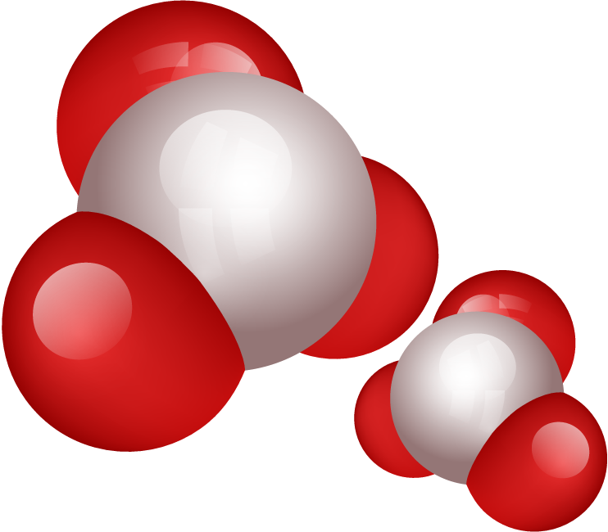
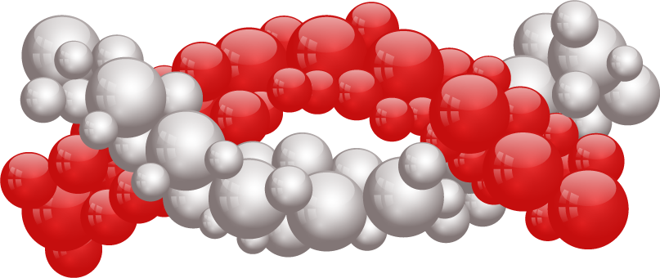
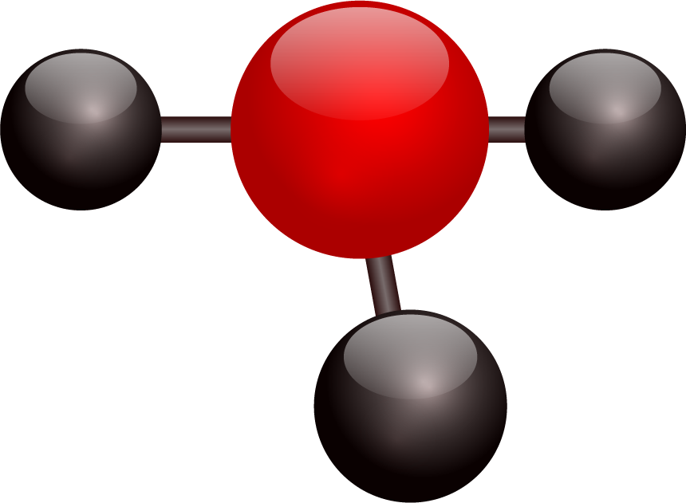
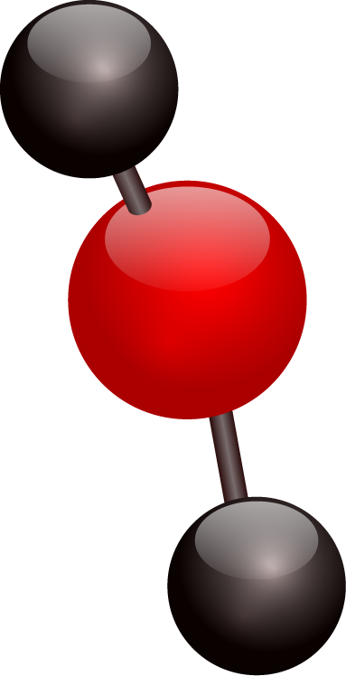
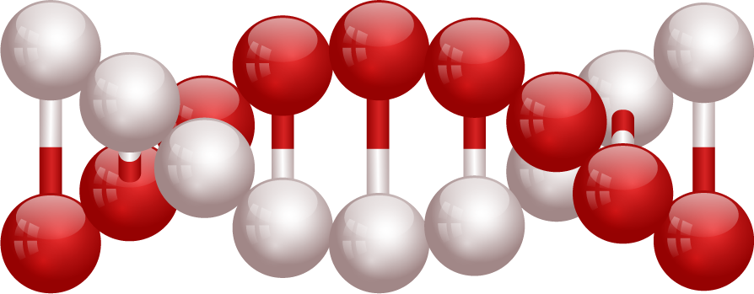
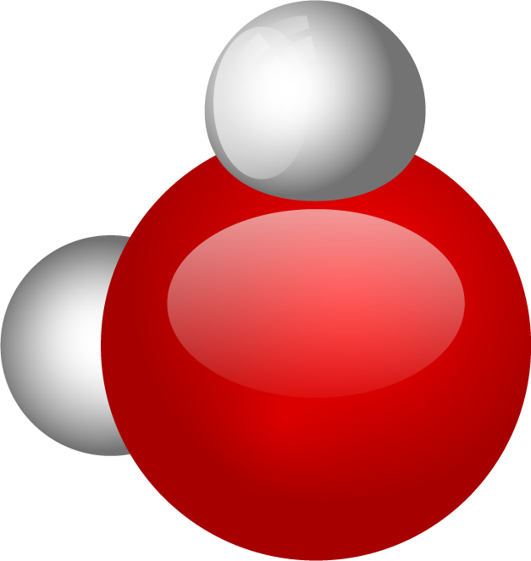
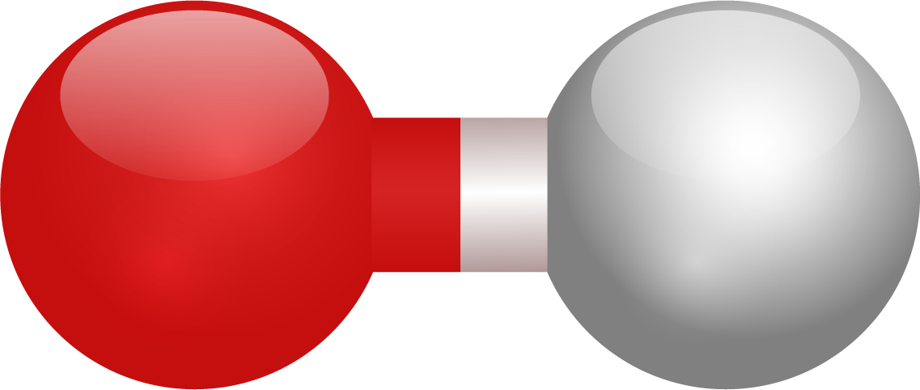
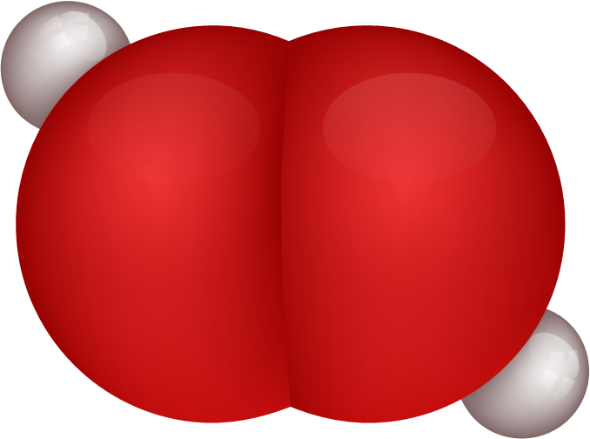
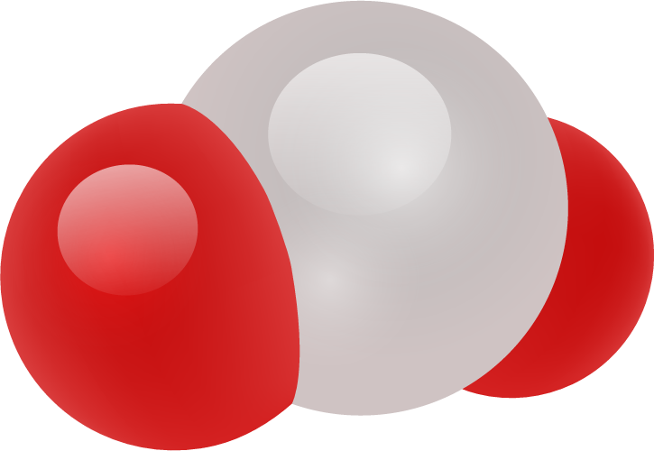
ALTERNATIVE RESOURCES

